Slide 1

Group 32
An HKU Survey Matcher Mobile App
Olano James Daniel Cubillas 3035777975
Chan Ching Yee 3035930187
Nafis Ul Islam 3035835571
So Ki Wai Grace 3035927116
Wong Hin Chi 3035806324

Slide 2
01
Problem
Statement

Slide 3
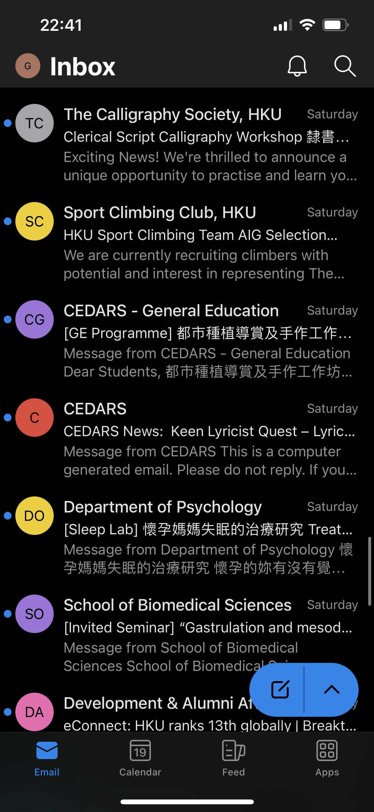

BOMBARDMENT
UNSYSTEMATIC
TEDIOUSNESS
😭 Payme? FPS? Voucher?
😭 Unsystematic reward mechanism
😭 Daily bombardment at 3am
😭 Miscellaneous topics
FORGETFUL
😭 Sort out and extract
😭 Non-stop recruitment
😭 Where? When? How MUCH?
😭 Missed the deadline
😭 Participant no show

Slide 4
02
Solution

Slide 5
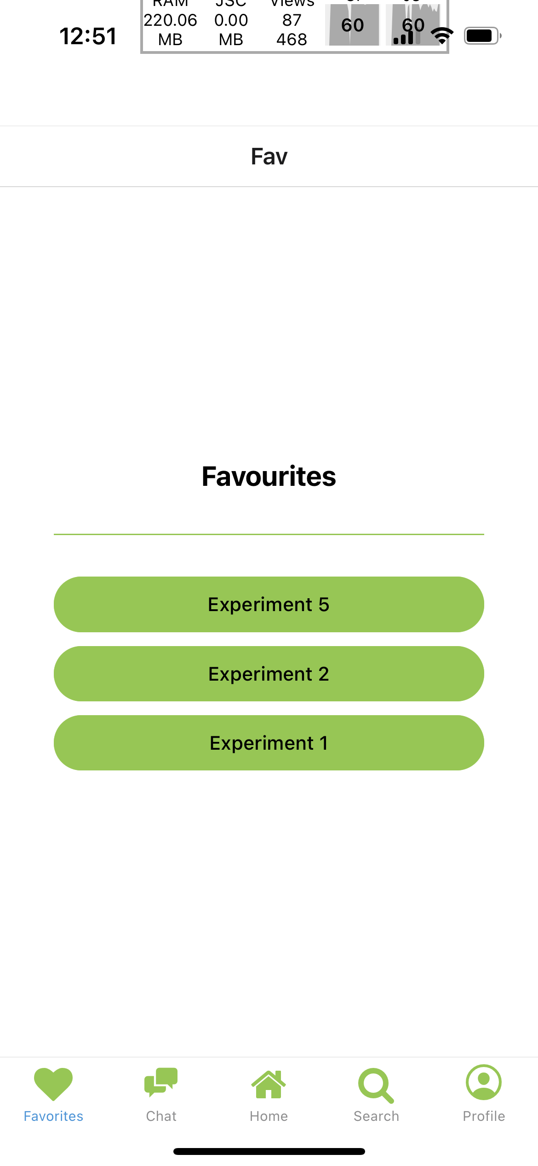
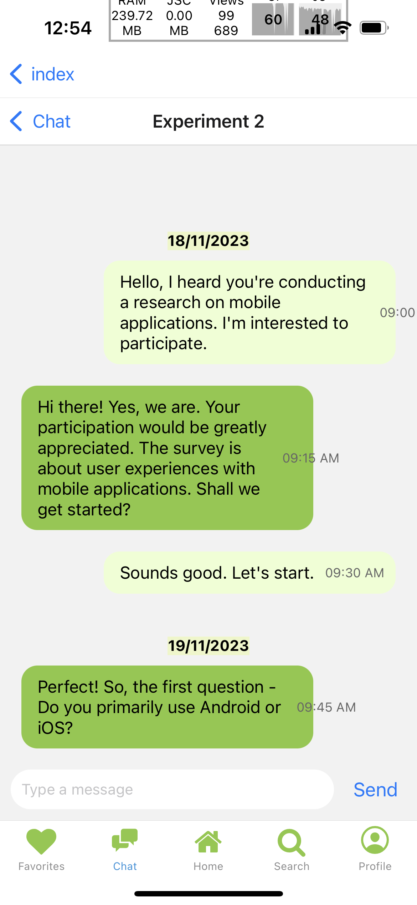
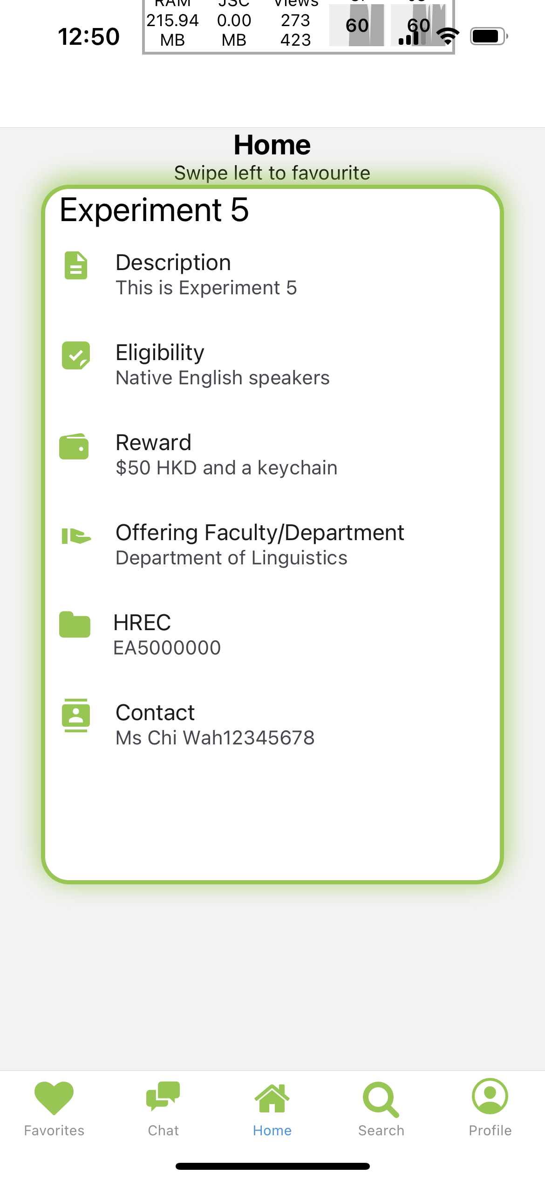
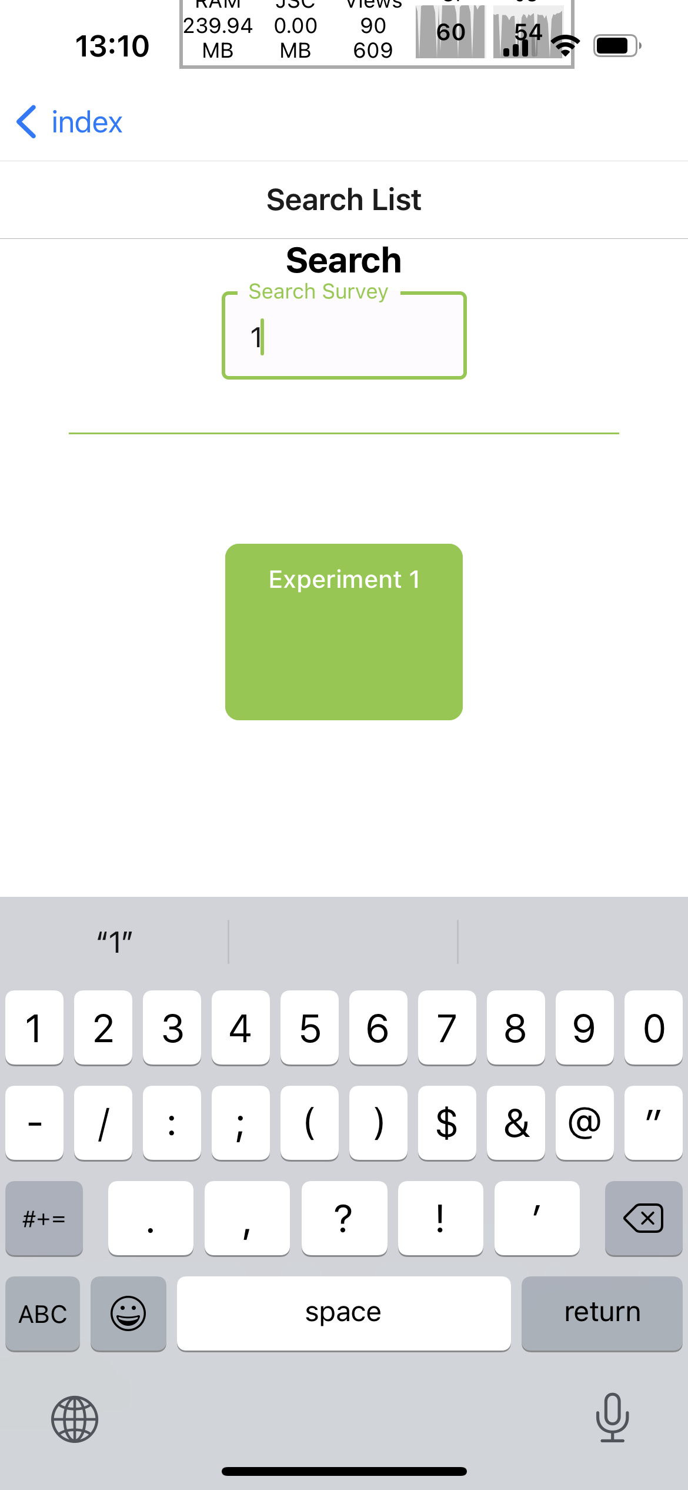
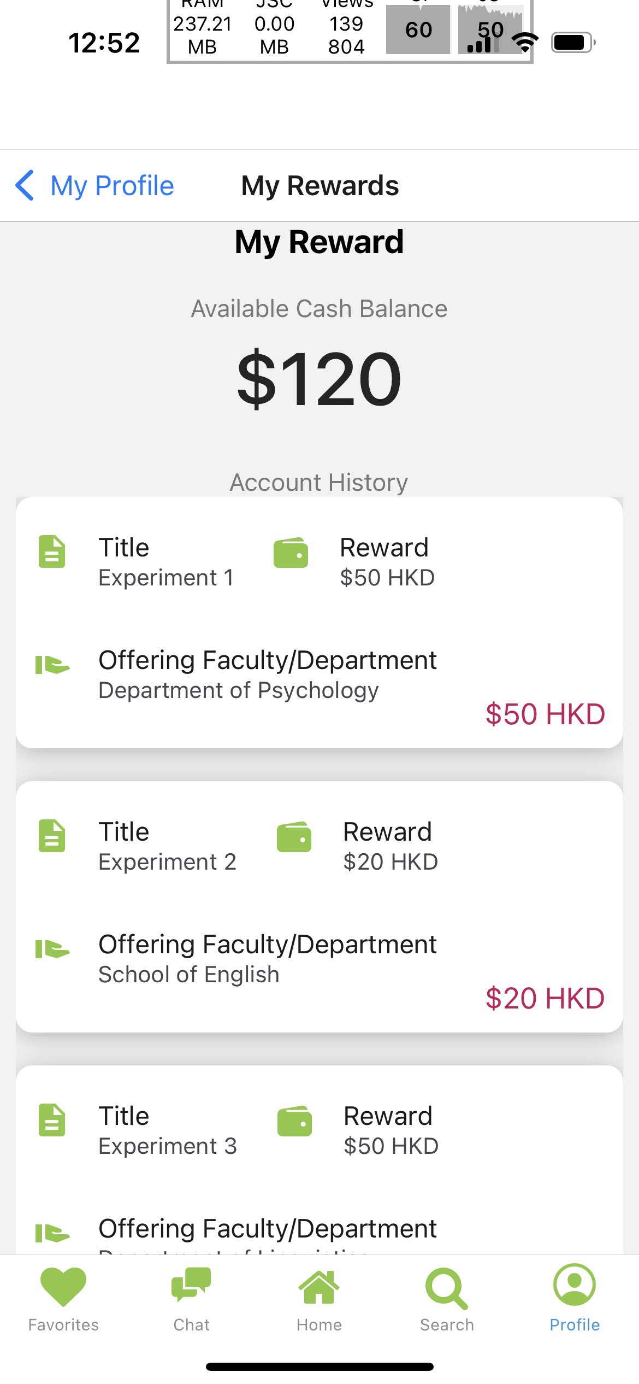
OnlySurveys
One-platform HKU Survey Matcher

Slide 6
App Objectives
Centralization
Attraction
Interaction
✓ Attractive rewards
✓ Easy match
✓ For clarification
✓ Follow-up
✓ Ease of access
✓ Dissemination of information
Notes:
Aggregate HKU-based surveys to students using one platform for ease of access and dissemination of information.
Let students discover surveys with attractive rewards through different methods.
Researchers can choose from a larger pool of participants with better user ratings, hence benefit from more accurate data by the larger data set and equally proactive participants.
Integrate a chat system for one-on-one conversation between candidates and researchers to clarify and follow-up.

Slide 7




Tech stack
React Native
Expo
Github
Visual Studio Code
Frontend Framework used
Open-source framework for building React Native apps with consolidated logic
Version control
Code editor

Slide 8
03
App Features & Demonstration

Slide 9
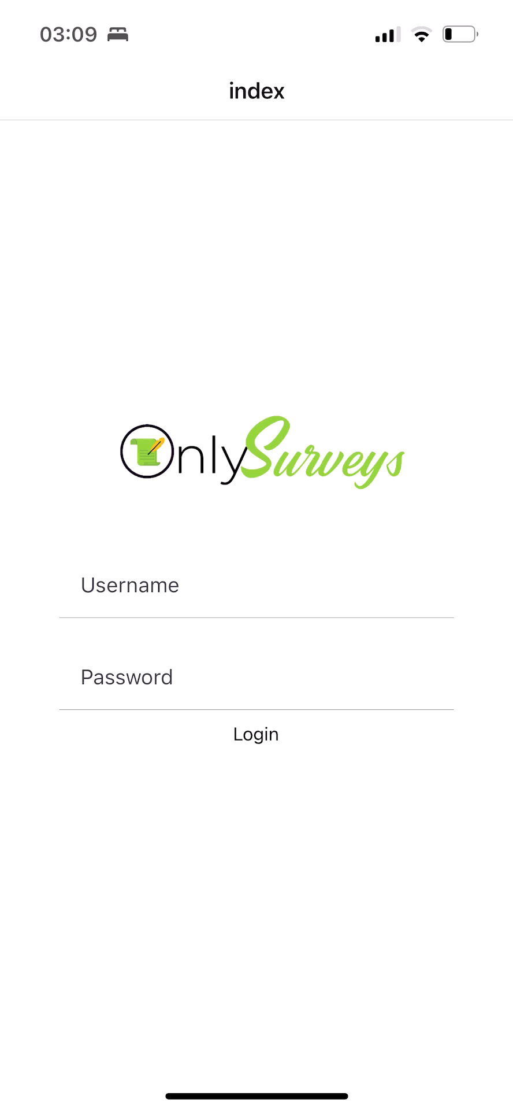
Login
Benefits
HKU Portal:
Identification: Student vs Researcher
Authentication
😄 Easy Login
😄 HKU Exclusive
😄 Role-Oriented

Slide 10
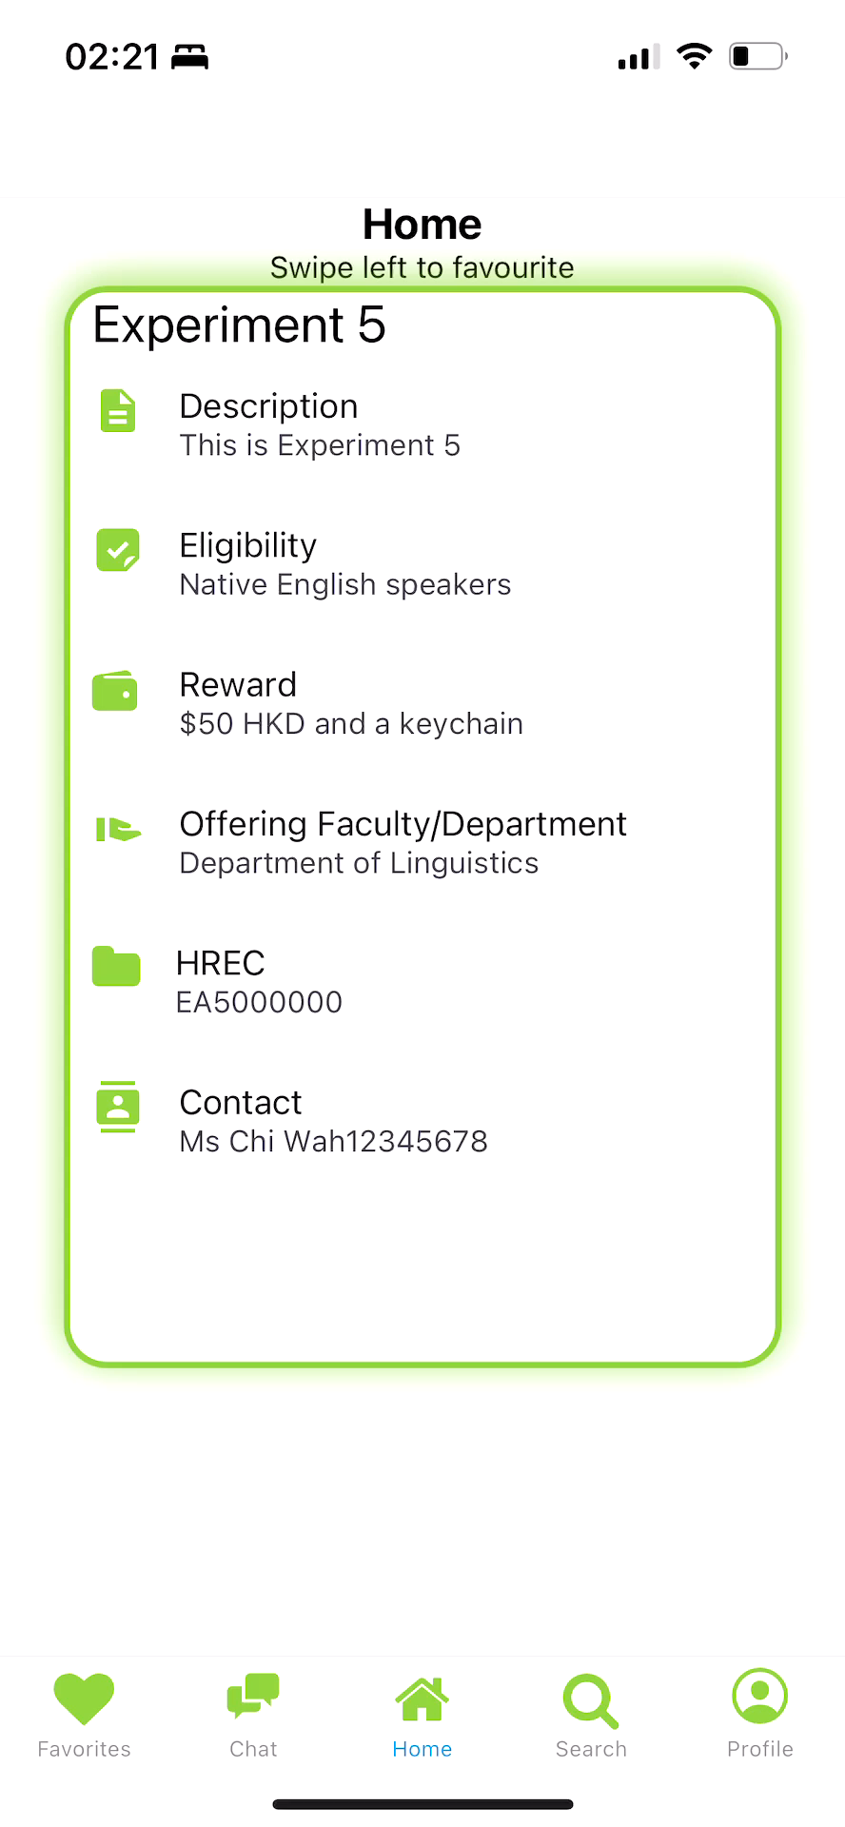
Home
Benefits
Swipe left: Interested 💖
Swipe right: Uninterested 💔
😄 Gamification
😄 Captivating
😄 Easy to use
😄 Efficiency

Slide 11
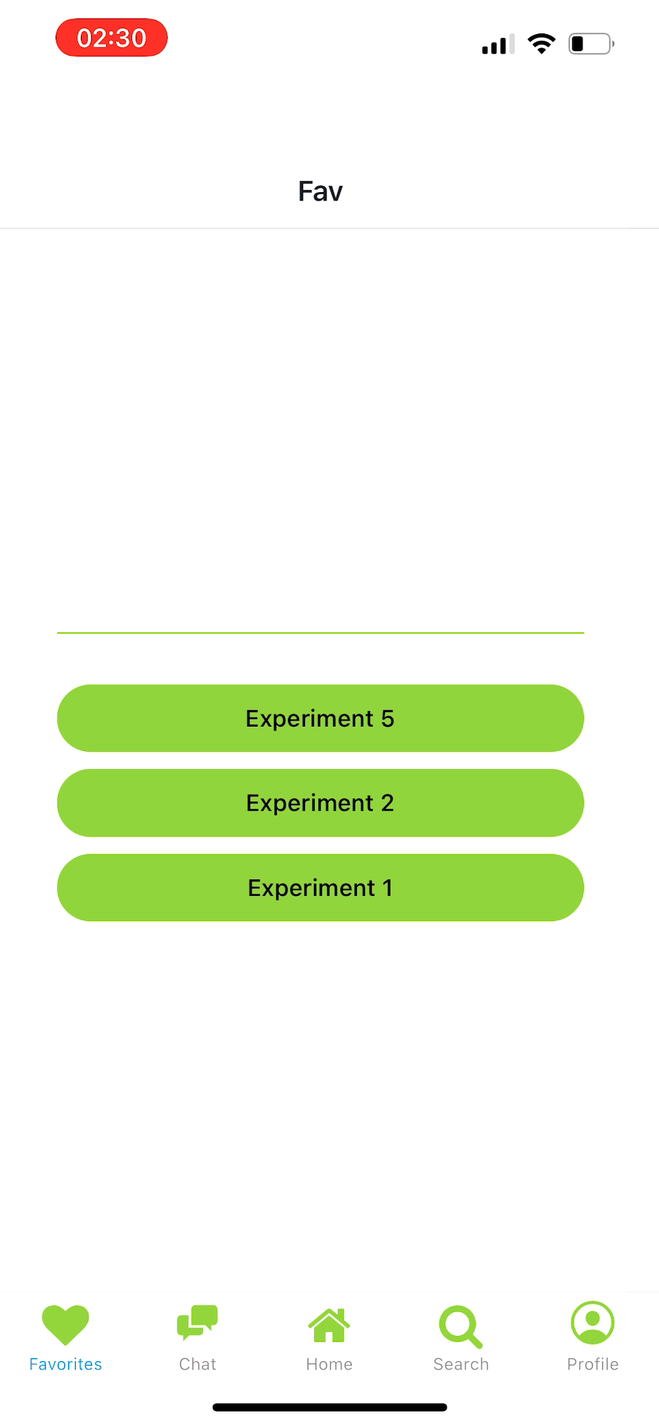
Favourites
Benefits
Keeping track of the interested ones
Quickly find details
😄 Ease of Access
😄 Organization
😄 Reminders
😄 Efficiency

Slide 12
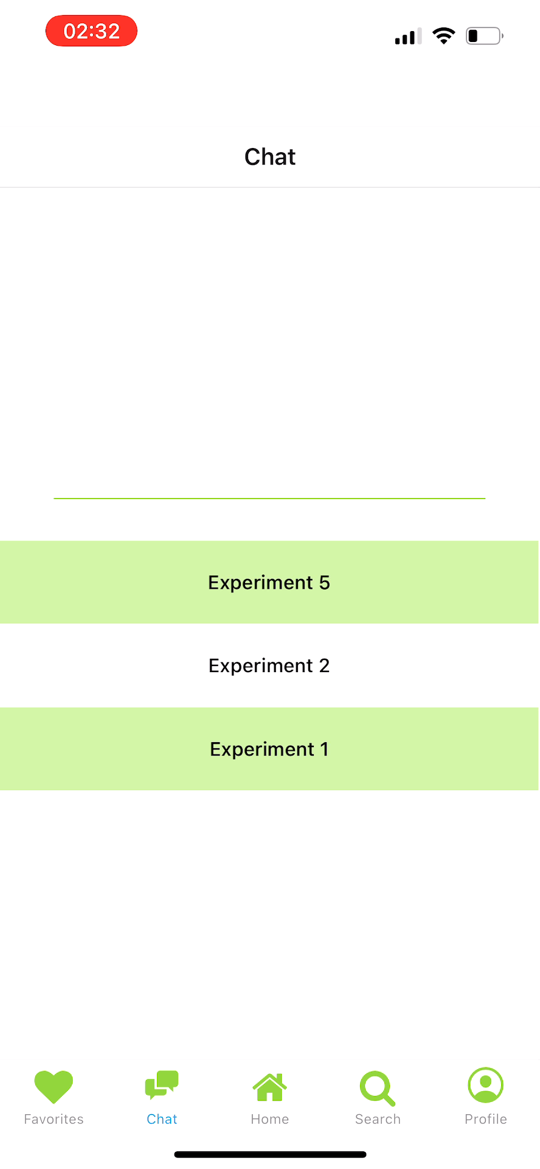
Chat
Benefits
Seek clarification and help easily
Follow-Up
😄 Informal
😄 Real-Time
😄 Convenient
😄 Communication

Slide 13
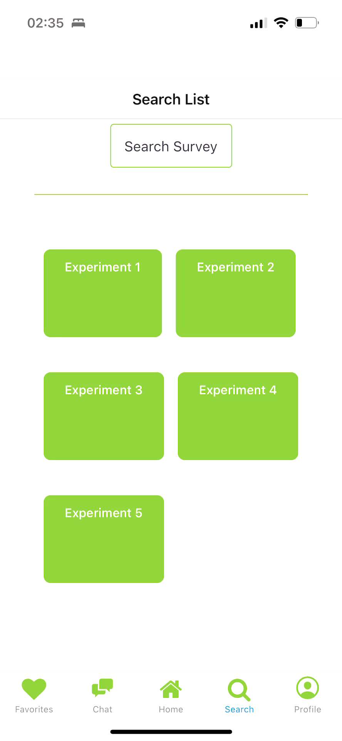
Search
Benefits
Search for keywords
Sort for interested surveys or experiment
😄 Convenient
😄 Accessibility
😄 User Behavior
😄 Data Analytics

Slide 14
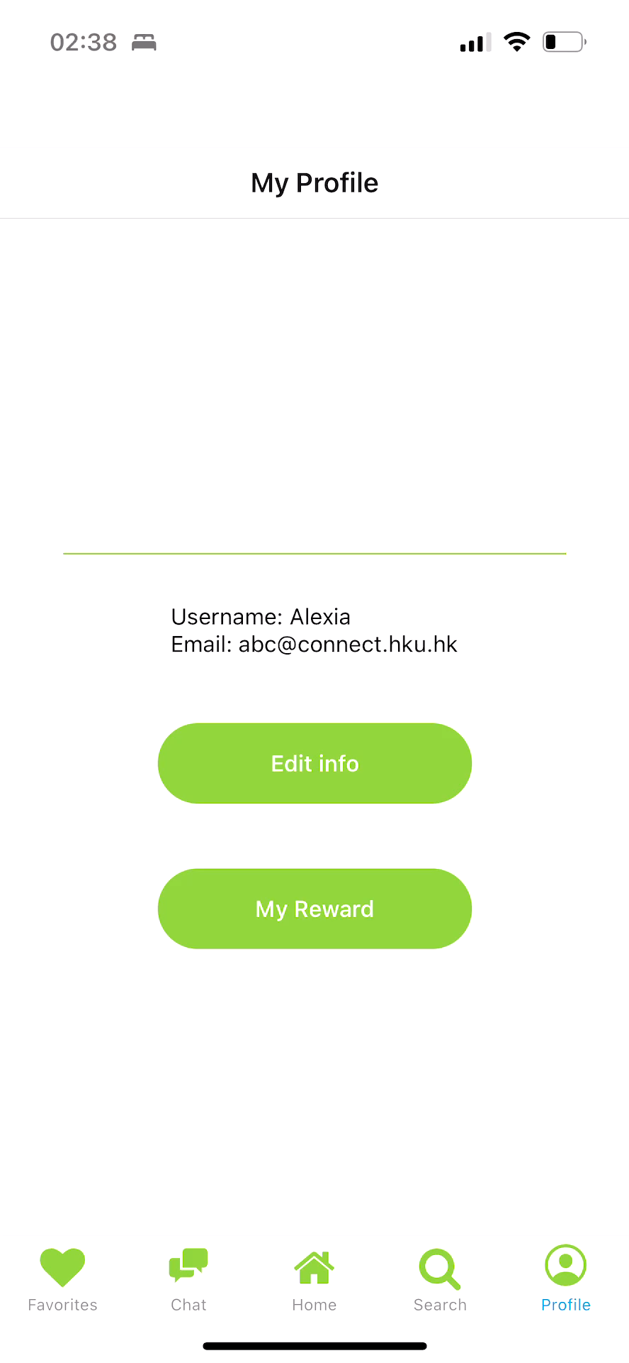
Profile
Benefits
User Information: Name, Email
Edit Name
Button to Reward page
😄 Personalization

Slide 15
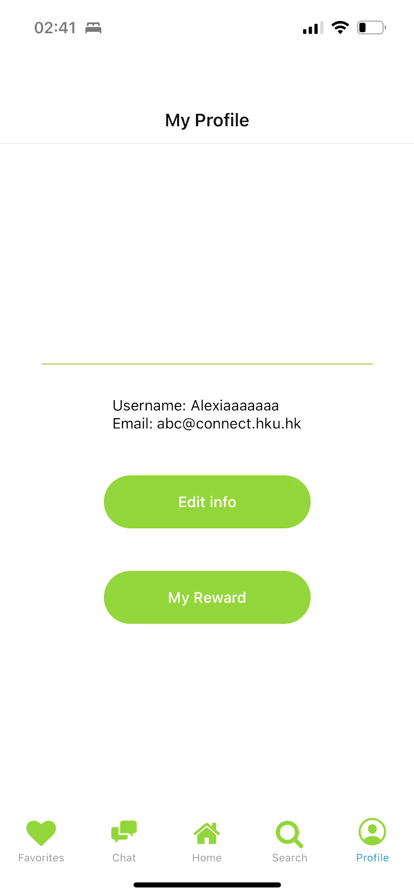
Reward
Benefits
Total Rewards
Reward History
😄 Organization
😄 Motivation
😄 Progress Tracking
😄 Gamification

Slide 16
04
Possible Future Development

Slide 17
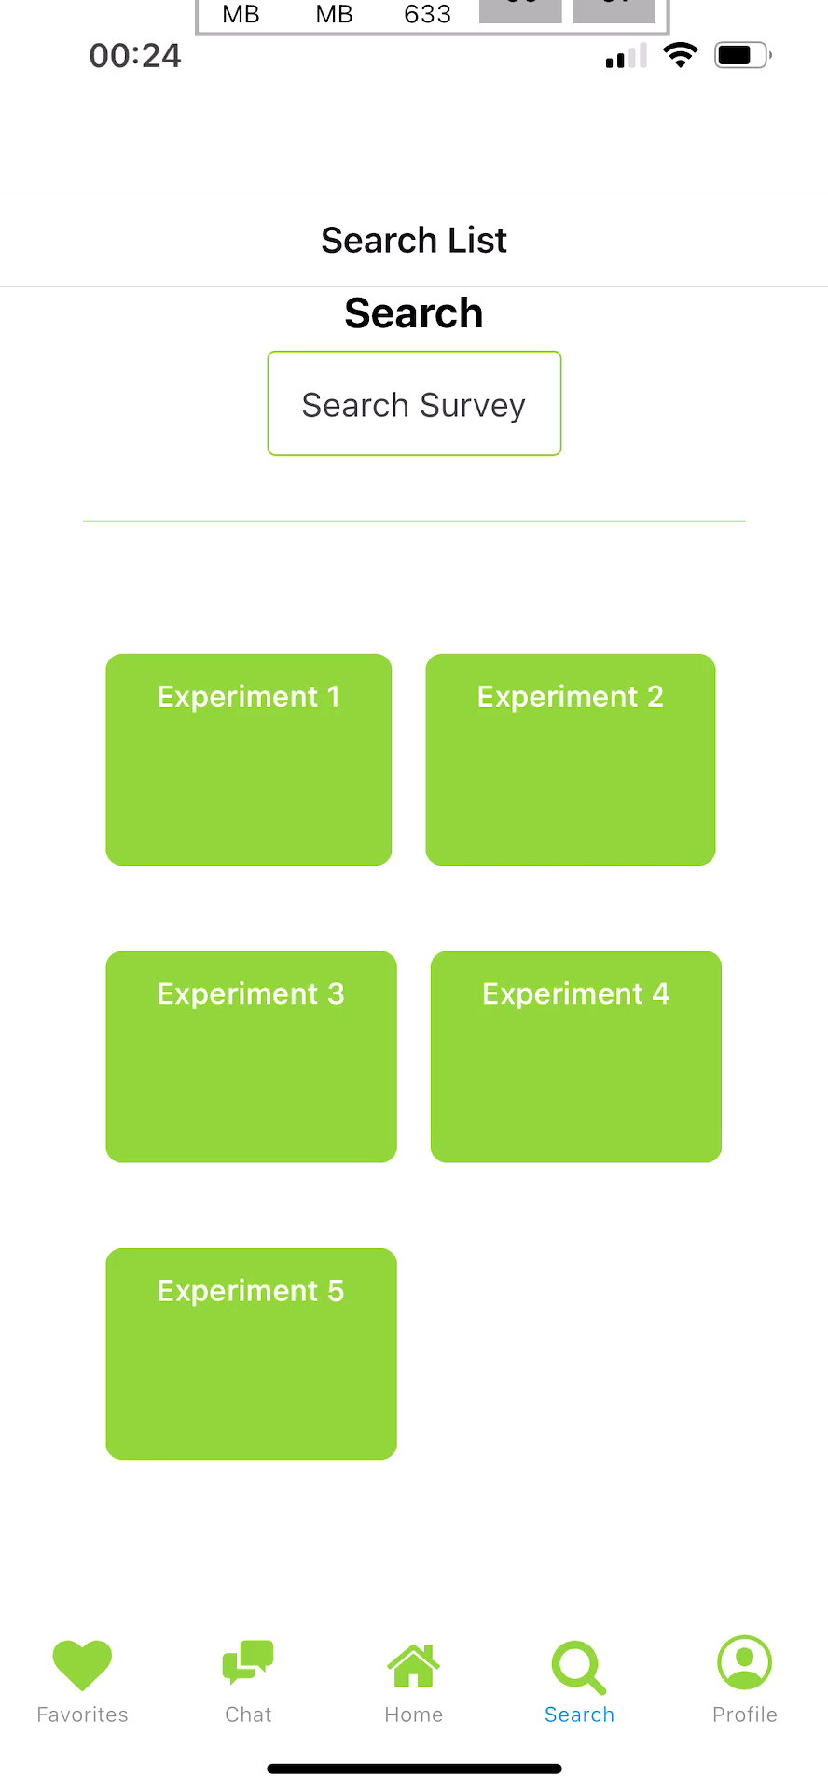
Future Search
Benefits
Sort for interested topics or rewards
😄 More Targeted
😄 Easier to find

Slide 18
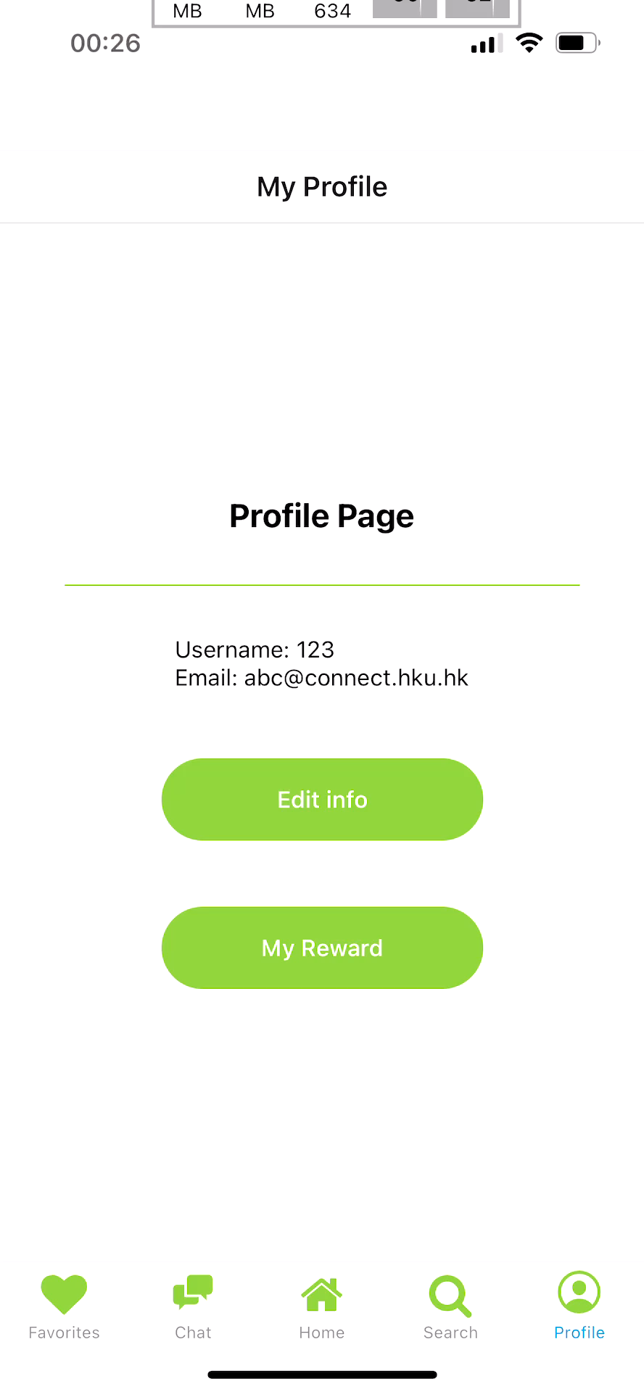
Future Profile
Benefits
User Information: Name, Email, Language, Health information (e.g., covid infection, blood type, eyesight), interests, major, minors
😄 More Personalized
😄 Better Matches

Slide 19
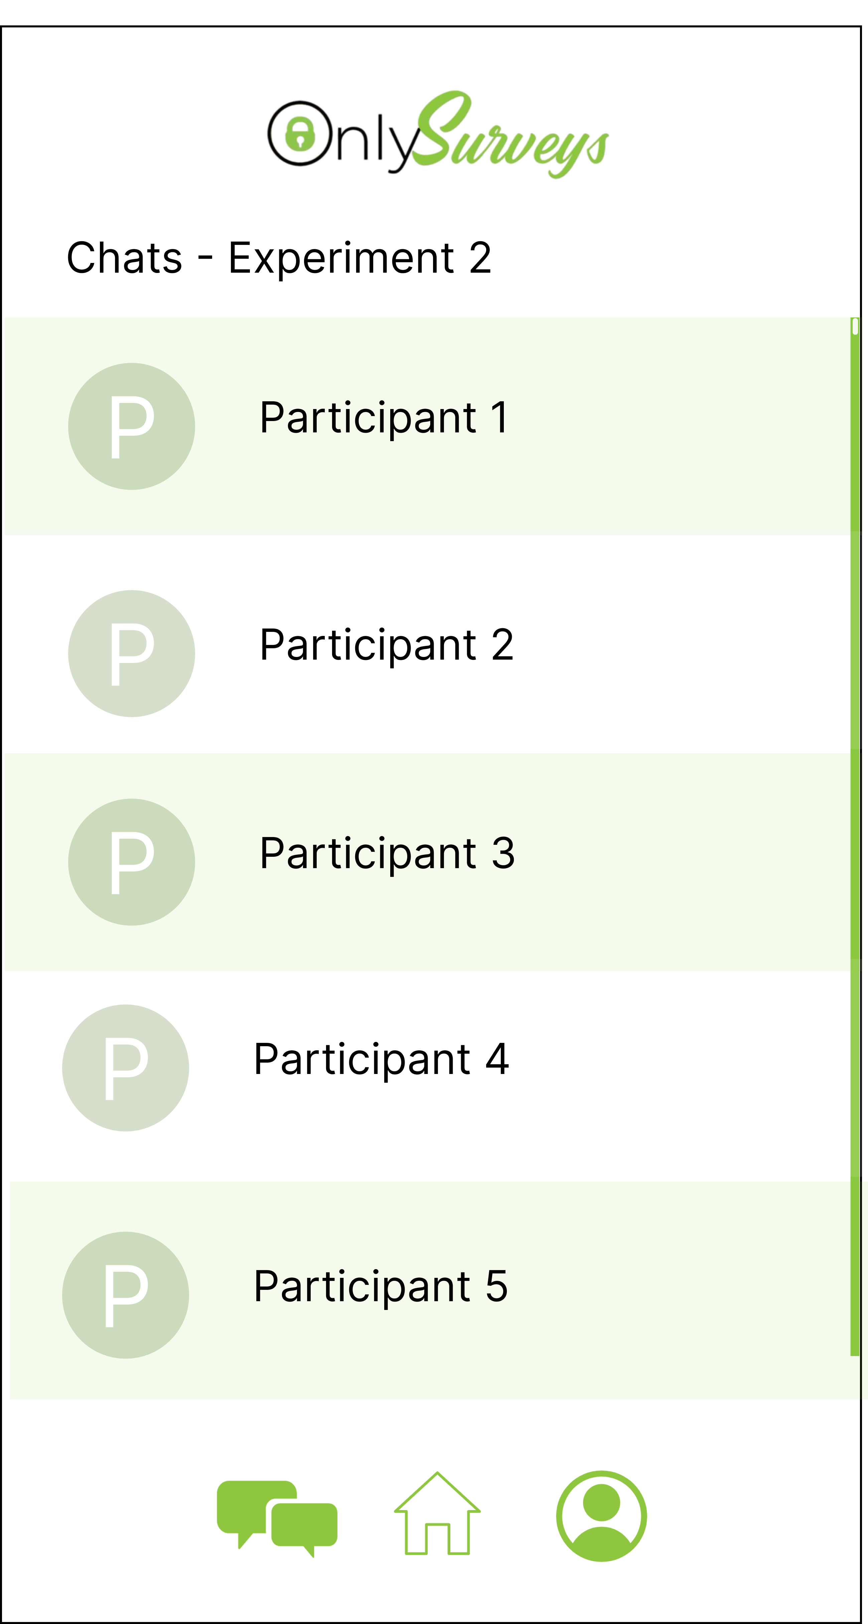
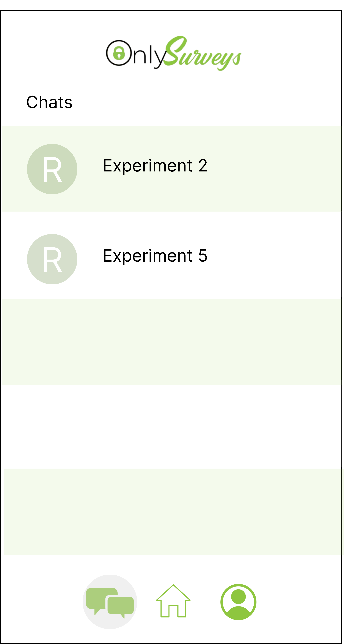
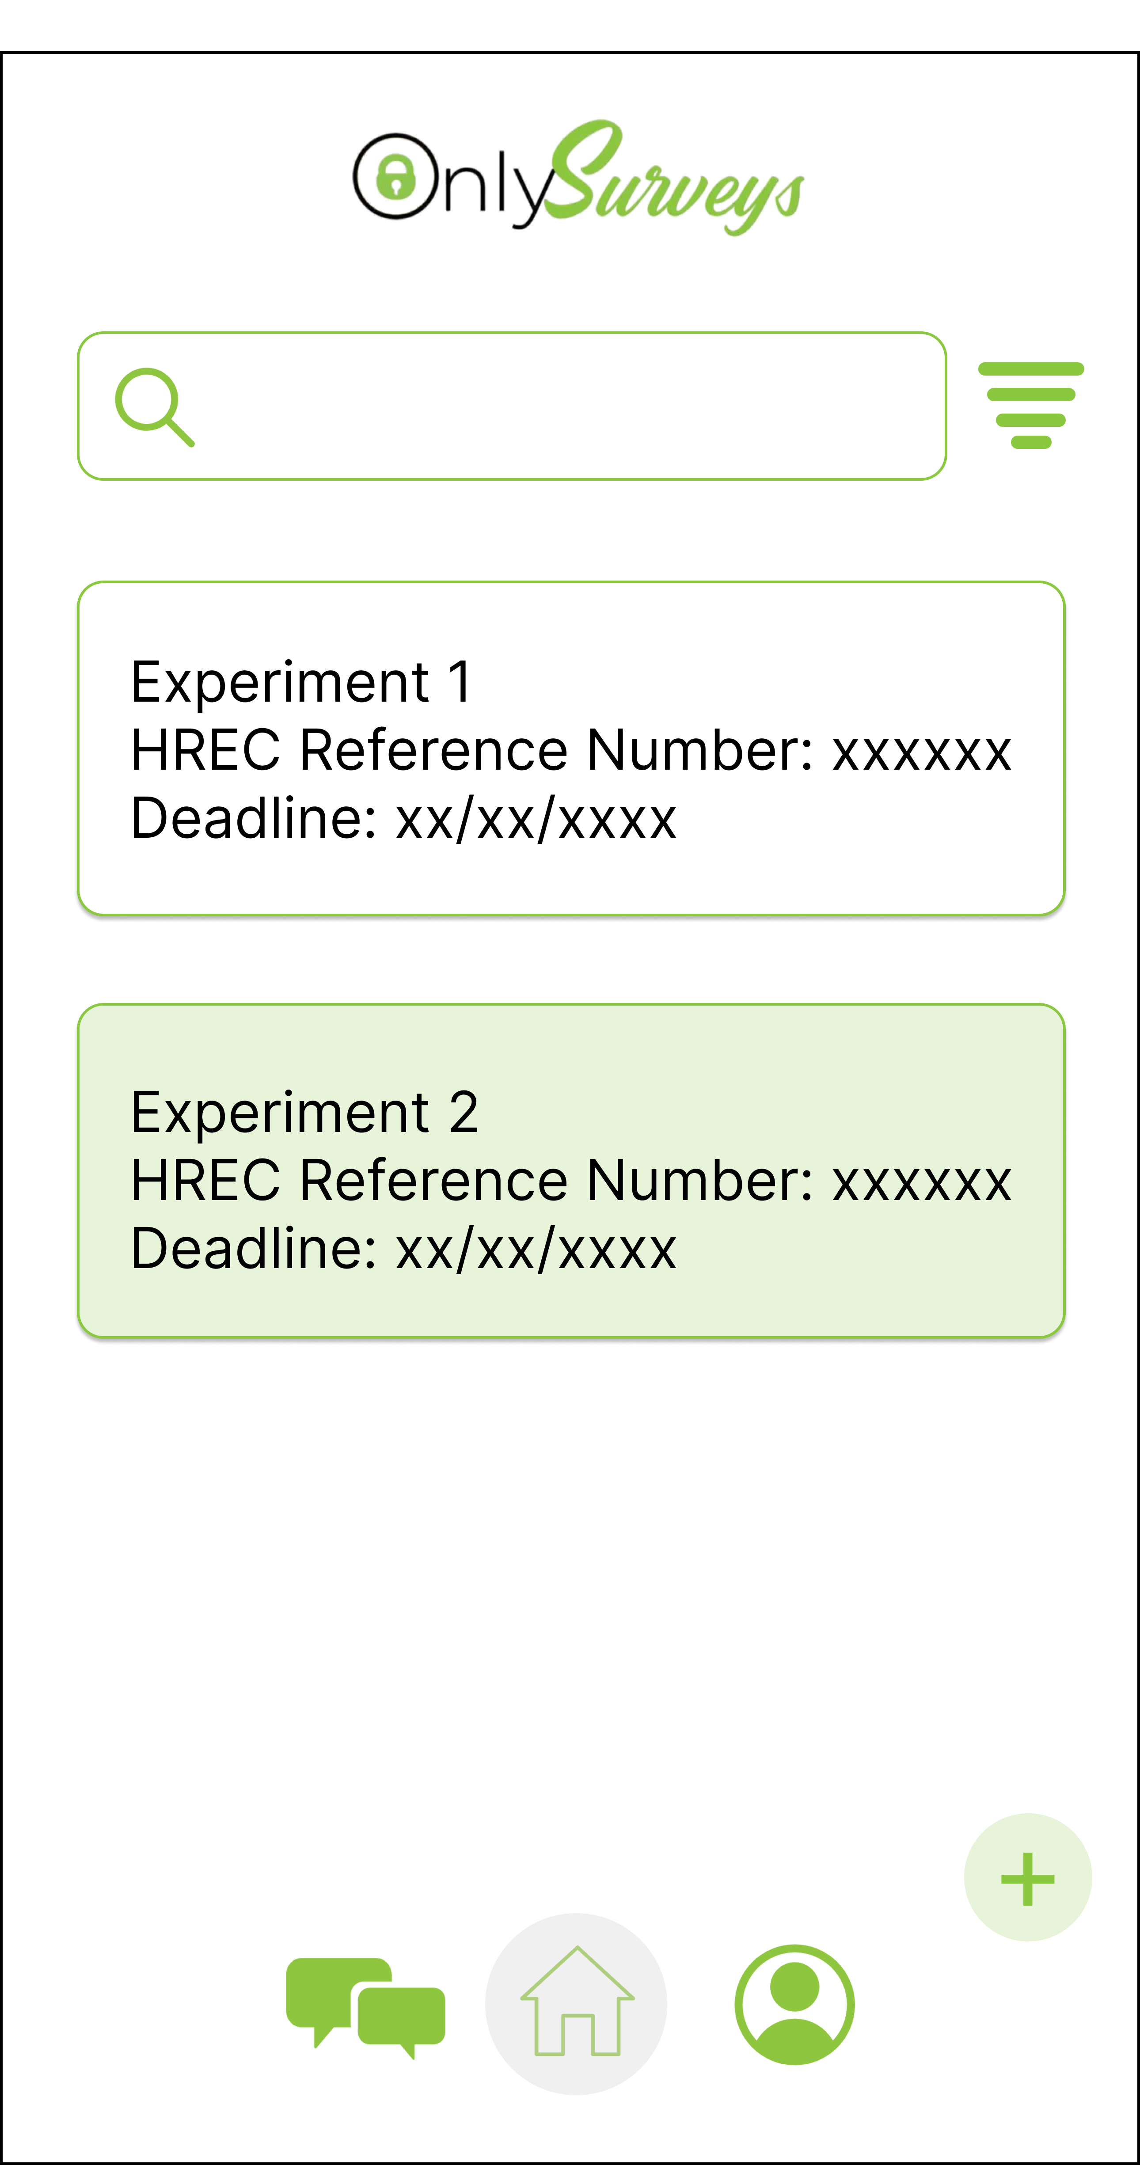
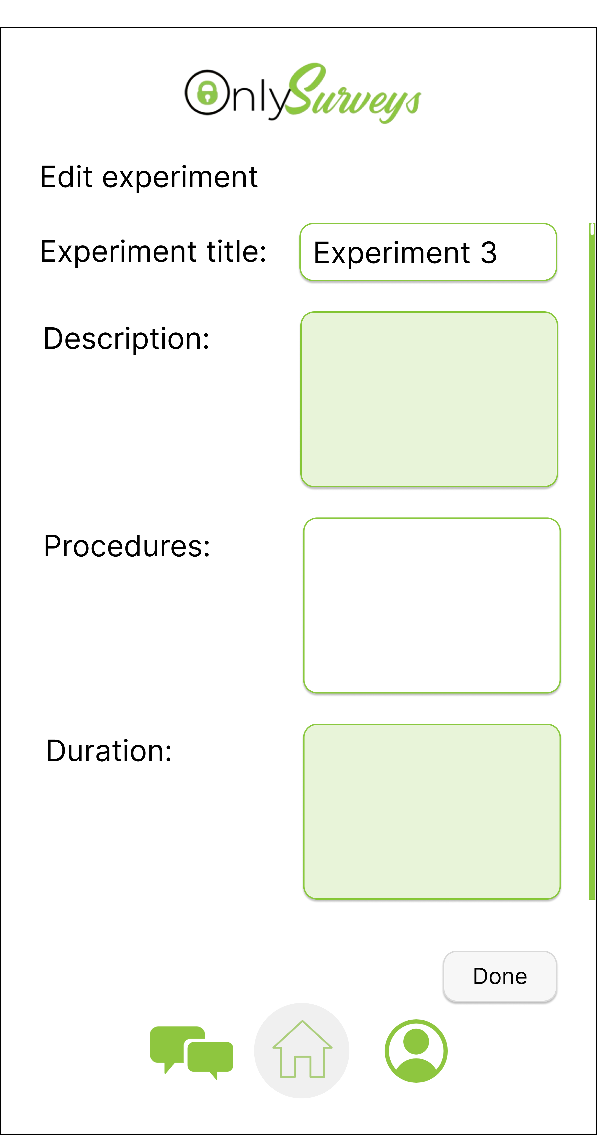

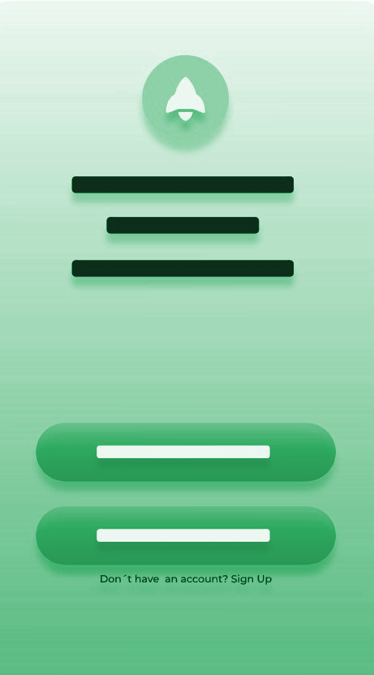
Interface for researchers
Better, Faster, Smarter

Slide 20
THANKS!

